Slide 1
Effective Communication Makes the difference
Troylynn Williams
Student Success Coach
NTCC

Slide 2
Ice breaker!
What comes to mind when you hear the word “communication”?
https://youtu.be/4Z1BIeje_ko

Slide 3
Effective Communication
Effective communication happens when you achieve positive results using communication to express your desired goals.
Is there something that I could have done, to send my message more clearly?

Slide 4
How to communicate with instructors
Visit instructor during office hours
Send an email
Call your instructor or schedule a virtual meeting
Notes:
At NTCC you have the option of reaching out to your instructor in the following ways:

Slide 5
Tips for office hour visits
Be mindful of your instructor’s time and arrive at your scheduled time
Be respectful and courteous
Have a list of questions ready
Accept constructive criticism or feedback, (it only helps you improve)
https://youtu.be/IkpWQHLY4A4
Notes:
Leave your attitude in your car.
Come with a list of questions, make sure you at least know what module or topic you are having trouble with. Think…when you go to doctor you can’t just say, “I’m sick” they ask you to describe your symptoms. Let your instructor know what you’re having trouble with so they can help you.

Slide 6
Email Tips
Check your school email regularly
Contact your instructor before missing a class or assignment
Begin and end emails with appropriate greetings
Include your L# in your email
Proofread! Make sure your email is free of grammatical errors and “text language”
Allow 48 hours for a response. Follow-up if you do not get a response within a week.
If you still have questions request a phone call or virtual meeting from your instructor.

Slide 7
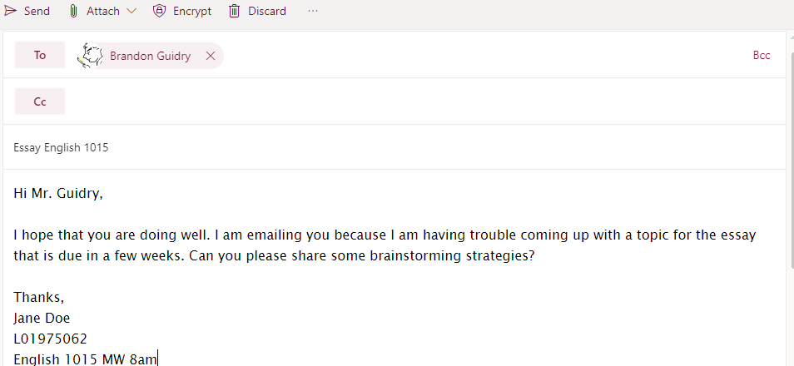
a good email is like a good sandwich It has layers…

Slide 8
Tips for phone calls and virtual meetings
Make sure there is no background noise.
Choose a quiet area that is free from distractions such as kids and pets.
(for virtual meetings) Dress appropriately.
Check your internet and phone connection prior to meeting.

Slide 9
What is your favorite method of communication?

Slide 10
Communication with classmates
If you can interact with other students online, do it.
Students who feel they are part of a learning community do better than those who feel isolated and on their own.
If you know another person taking the same course, try to coordinate your schedules so that you can study together and talk over assignments.

Slide 11
Effective Communication Can….
Help you grow and mature academically and personally…
Contribute to success in online classes
Help you receive academic advice and references
Build meaningful networking relationships
Earn respect from your instructors and
peers

Slide 12
References
https://open.lib.umn.edu/collegesuccess/chapter/7-3-communicating-with-instructors/
https://youtu.be/4Z1BIeje_ko
https://youtu.be/IkpWQHLY4A4
Email us:
successcoach@northshorecollege.edu

